Slide 1
Common Requirements for Large LabVIEW AT Systems (and an illustration of how to solve some of them)
Elijah Kerry, Certified LabVIEW Architect (CLA)
Principal Product Manager, Software Platform

Slide 2
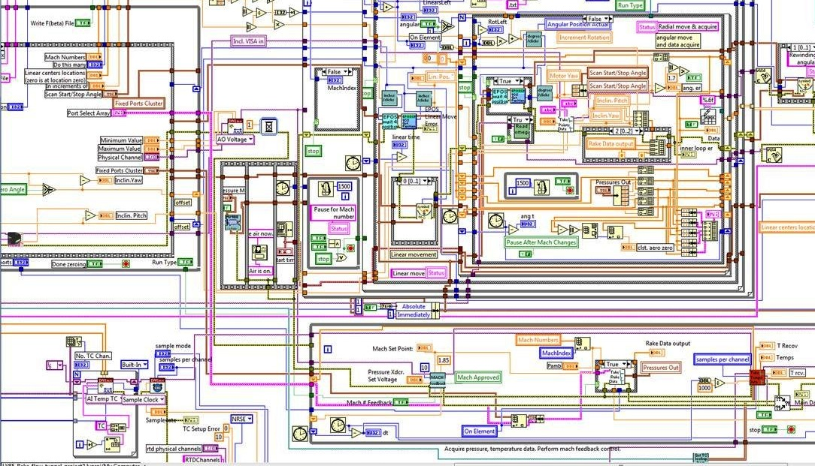

Slide 3
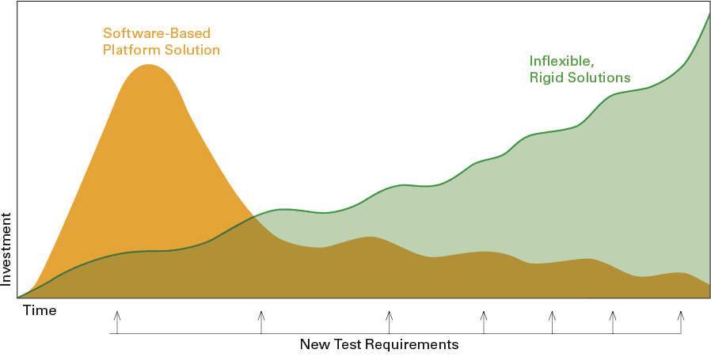
Investment Profile of Software
Notes:
A lot of LabVIEW programmers tend to look at some of these tools and processes as overhead and as time not spent doing development. It’s true that there is a non-zero cost to adopting many of these practices and the associated tooling, but their prevalence in industry is evidence of the long-term benefit. People who just jump right in to coding without source code control, requirements management solution, code reviews, etc… may get off to a quick start, but they tend to end up with brittle, inflexible code that is difficult and costly to maintain.
Today’s presentation seeks to persuade you that it’s worth investing in some or all of the tools you’ll see today, and that the initial investment will drive down the long-terms costs associated with building, developing and maintaining this system. This is especially true in applications that need to work for very long periods of time with the expectation that they will support new hardware and measurement capabilities as they become available.

Slide 4
Common Requirements
Software needs to scale and adapt to new requirements with minimal rework
Reuse of common IP should be maximized across similar applications
Other individuals need to be able to add add functionality, but they won’t necessarily be architects
The system needs to be updated remotely and ideally without rebuilding the entire application

Slide 5
http://bit.ly/lv_oomal
Measurement Utility Reference Example

Slide 6
Primary Goals
Define an architecture that allowed other developers to add functionality (ie: ‘plugins’) without modifying the calling framework
Determine the best way to give people writing plugins starting points that included the necessary APIs, parent classes, and stub code in order to minimize the work required
Develop a strategy to deploy the framework as an executable and manage common dependencies of those plugins appropriately
Explore the implementation of a hardware abstraction layer, or HAL, which quickly also led to the creation of a measurement abstraction layer, or MAL
Notes:
Here are some of the more dominant themes that drove the design decisions I made for this architecture. Think of these as high level requirements for the system

Slide 7
Secondary Goals
Understand how to compartmentalize code for the sake of enabling large teams of developers
Explore the mechanisms for managing communication amongst multiple dynamically-spawned, free-running processes
Package and distribute source code for the sake of reuse
Enable the plugins to be installed (or even uninstalled) separately from the deployed copy of the framework
Sequence the execution of these plugins via TestStand
Notes:
These high level requirement led to secondary goals that I quickly realized would be necessary in order to satisfy some of the requierments I just showed

Slide 8
Demonstration
Overview of Reference Architecture

Slide 9
Two Common Abstractions
Abstract at layers where you expect to have a number of items that share a common interface and reuse common functionality
Measurements
Hardware
Expecting to add additional measurements or tests to a system over-time
Expecting to replace hardware and/or support systems with different hardware
Furthermore, I want the concrete definition of a Measurement to use the abstract interface for hardware, but it needs to be a specific type of device
Not all devices will have the same interface – so how do we handle that?

Slide 10
Hardware Class Hierarchy
Hardware
Defines device specific interface
Power Supply
DMM
Scope
Generator
PXI-4110
Simulated
Simulated
34401a
PXI 4070
Simulated
PXIe-5185
Simulated
Notes:
Unlike the measurement class, which was just one layer deep, the hardware class actually has an intermediate layer to define certain types of hardware. This way a measurement can request a SCOPE or a DMM, and a user can write the implementation knowing they’ll have a SCOPE or DMM, but without necessarily knowing which exact one. Here again we have plugins, which represent the concrete implementations.

Slide 11
Measurement System Class Hierarchy
Base
Controller
User Interface
Measurement
Results
Test Step Controller
Operator UI
Strain
Resistance
Diode I-V
Frequency Curve
Voltage
Notes:
So these are the actors in this system. Quick explination of each. Think of this as a crude form of UML: we’re seeing the class hierarchy of our system.

Slide 12
How Does the Measurement Use Hardware?
Actor
Controller
User Interface
Measurement
Measurement
Results
Hardware
Diode I-V

Slide 13
OOP Crash Course

Slide 14
What is a Class?
A class is basically a cluster
I/O
Clock
Measurement Class
=
Samples
Raw Data
Task
Measurement Data
A class contains data, plus
methods (VIs) that are allowed
to act upon and modify the data.
VIs that do not belong to the class
cannot act upon the data

Slide 15
This simple illustration shows how these three operations we started with now just act upon the data within the cluster
I/O
Graph
Clock
Samples
Raw Data
Task
Configure
Acquire
Measure
These VIs are explicitly coupled to this data

Slide 16
Measurement
Graph
Configure
Acquire
Measure
The object wire can be passed into any VI that has the class on the connector pane, but only VIs that belong to the class can directly bundle and/or unbundle the data

Slide 17
Inheritance Allows Descendant Classes to Modify, Extend and Add Functionality of a Parent
Measurement
Strain
Diode Characterization
Finite measurement of a single channel
Applies stimuli before acquiring value
These are children of the measurement class

Slide 18
Graph
Configure
Acquire
Measure
Q: Isn’t this the same thing as using case structures inside these VIs ?
I/O
Clock
Samples
Raw Data
?
?
?
Graph
Task
Configure
Acquire
Measure
Measurement Type

Slide 19
A: It’s conceptually similar, but there are extremely important differences…(NO)
To understand the difference, first consider the impact of introducing a new measurement in the non-OOP example.
3. We probably have to add new elements to this data cluster
I/O
2. We have to modify all of these VIs
Clock
Samples
Raw Data
Graph
Task
?
?
?
Configure
Acquire
Measure
Measurement Type
1. We have to add a new type to the enum

Slide 20
I/O2
As the scope of the data cluster expands, we are passing data into large segments of code inside the cases that should not have access to it. Our data is not protected
DIO
Trigger
I/O
Clock
Samples
Raw Data
Graph
Task
?
?
?
Configure
Acquire
Measure
Measurement Type
Introducing a new measurements requires changes within the VIs, as well as the calling code (sometimes referred to as a framework). This makes code very costly to maintain and brittle

Slide 21
Sibling Classes Have Unique Data Scope
Task
Data that every measurement needs to have
I/O
Samples
Measurement
Bridge Type
Output Steps
Settling Time
Strain
Diode Characterization
Data unique to these specific measurements, plus ‘exposed’ data of parent measurement

Slide 22
One of the biggest differences: this new functionality has to be added at edit time.
What if you want to load a new measurement into your calling system at run-time?
I/O2
DIO
Trigger
I/O
Clock
Samples
Raw Data
Graph
Task
?
?
?
Configure
Acquire
Measure
Measurement Type
Yes, you can dynamically load the VIs called by these VIs, but you have to have pre-defined the data they have access to. The data in the cluster wire cannot be changed at run-time, as the connector pane must match exactly.

Slide 23
At edit-time, LabVIEW shows us the wire of the parent class we have said will be passed along this wire (in this example: Measurement.lvclass)
Graph
Configure
Acquire
Measure

Slide 24
We may pass any child of this class down this wire at run-time. Dynamically dispatched methods will execute the copy belonging to the run-time instance.
?
Graph
Configure
Acquire
Measure
LabVIEW can load a new child at run-time. The class will bring it’s methods and it’s data cluster into memory when loaded. This makes it possible to add functionality without modifying calling code. The code to load a child class is referred to as a Factory.

Slide 25
Group Exercise
“About that ‘Graph’ output… what if my measurements output different data types?”
Strain
Graph
Configure
Acquire
Measure
Temp
X
Boolean
Configure
Acquire
Measure
Dynamically dispatched VIs must have the same connector pane. You cannot have a different data type output on ‘Measure.’ So how do we solve this problem?

Slide 26
How can an instance of the measure method return information that is appropriate and specific to the measurement class it belongs to?
Consider the following requirements:
We have to pass different data-types at-run time out of the measure method
We always know a specific measurement will return a certain type of data
We need to be able to display that data to a user in an appropriate format
We need to pass the data back to a framework that implements a pre-defined interface for operations like ‘dispaly,’ ‘save,’ etc…
?
Measure
Is a variant a valid solution? (NO)
We can pass any data-type on a variant wire
How do we know how to display the data on a variant wire to a user?
If we pass the variant to our calling code, how will it know how to save it to disk or display it to the user?

Slide 27
Use a Class Hierarchy
Measurement Result
Defines methods all results should be able to define, such as ‘Save,’ or ‘Display’
Strain Result
Temp Result
Diode IV Result
Each has a unique private data cluster to store the result of a measurement and defines how that data is stored or displayed using dynamically dispatched methods that override the interface defined by the parent ‘Measurement Result’

Slide 28
Defining Plugins

Slide 29

Hardware Class Hierarchy
Hardware
Common
Components
Power Supply
DMM
Scope
Generator
Built into Executable
Dynamically Loaded at Run-Time
34401a
HW Plugin
PXI-4110
Simulated
Simulated
PXI 4070
Simulated
PXIe-5185
Simulated
Notes:
Unlike the measurement class, which was just one layer deep, the hardware class actually has an intermediate layer to define certain types of hardware. This way a measurement can request a SCOPE or a DMM, and a user can write the implementation knowing they’ll have a SCOPE or DMM, but without necessarily knowing which exact one. Here again we have plugins, which represent the concrete implementations.

Slide 30
Measurement System Class Hierarchy
vi.lib
Actor
User-Developed Code
Controller
User Interface
Measurement
Results
Application
Specific
Test Step Controller
Operator UI
Statically linked
Dynamically Loaded at Run-Time
Plugin
Strain
Resistance
Diode I-V
Frequency Curve
Voltage
Notes:
Lets break this down further. Obviously, everything but vi.lib is user-developed code, but going back to those original goals, we want to minimize the work required to add new functionality. We want to make it possible for someone to add new functionality without being an expert in all the underlying code of this system, or even having to have access to it on their system.

Slide 31
Developing a Plugin
DEPENDENCIES
DON’T NEED TO SEE OR EDIT
vi.lib
Actor
Common
Components
Common to Application and Plugin
Controller
User Interface
Measurement
Results
DON’T NEED AT ALL
Application
Specific
Test Step Controller
Operator UI
Statically linked
Dynamically Loaded at Run-Time
Plugin
Diode I-V
Frequency Curve
Notes:
What we really have is a code-base that’s common to multiple consumers: the person developing the framework (which includes the business logic, UI, etc..) and the person(s) developing measurements. The role of designing this code and defining the interfaces should definitely be in the hands of an architect. Our application-specific code will be our top-level code (testStep controller contains the main.vi that will launch the entire system).
A plugin for this system will contain the definition of a measurement and the format of the results that will be returned.

Slide 32
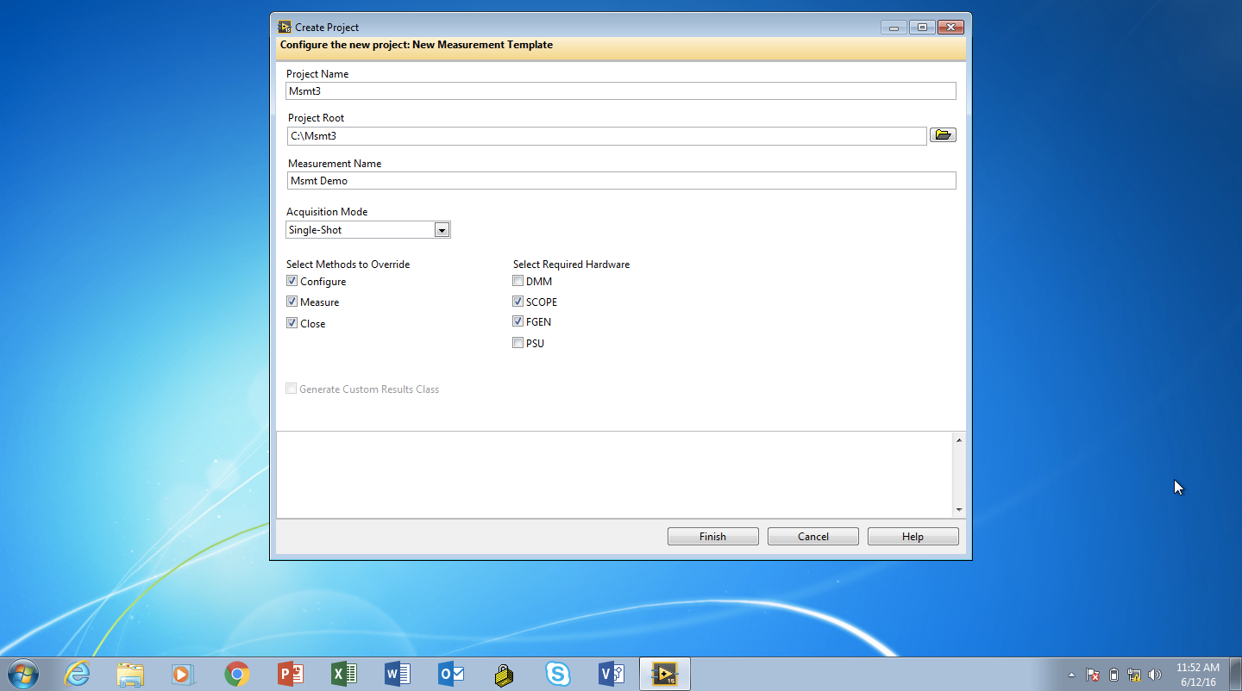

Slide 33
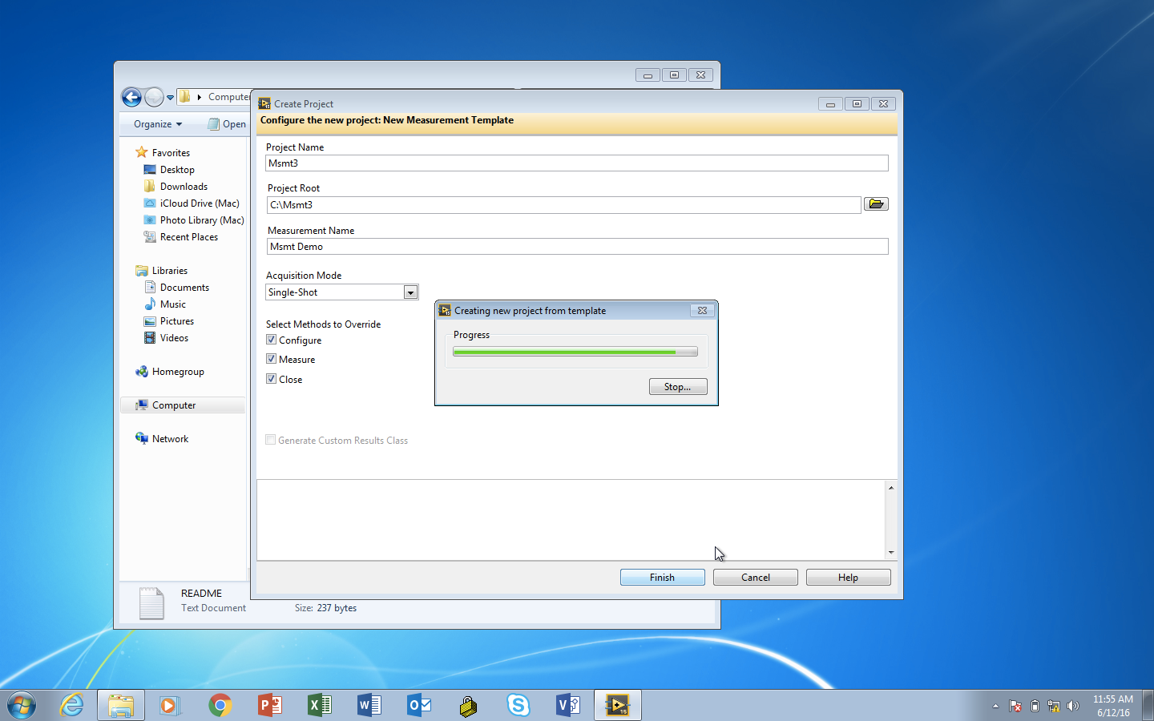

Slide 34
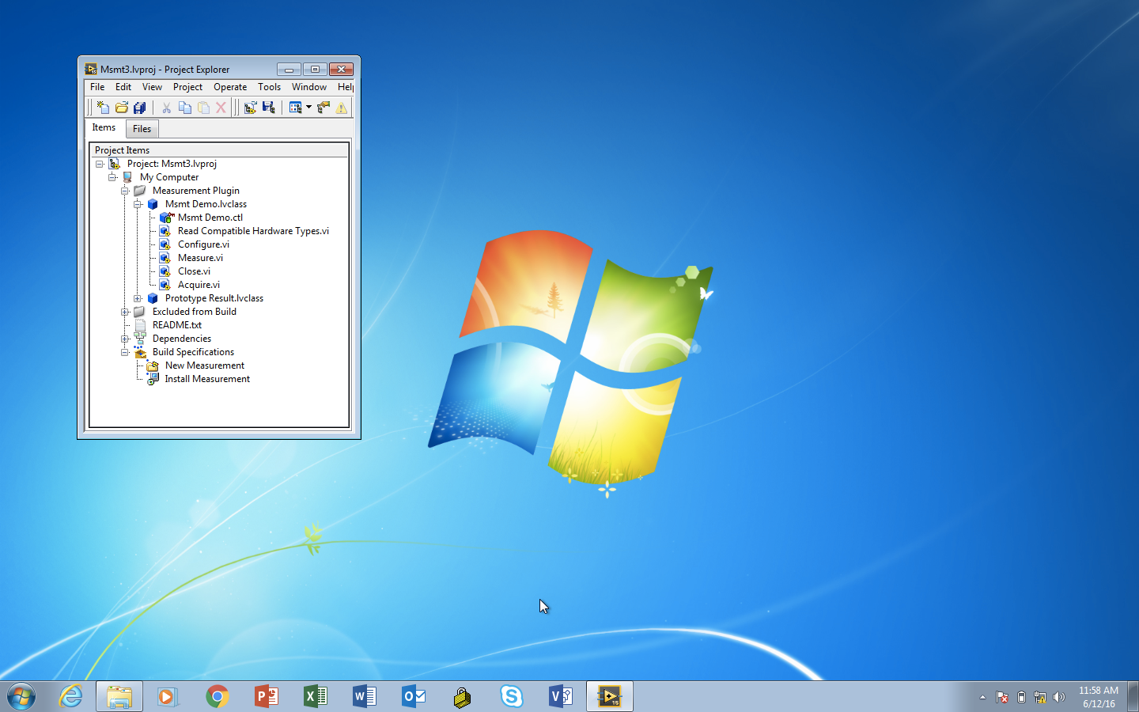

Slide 35
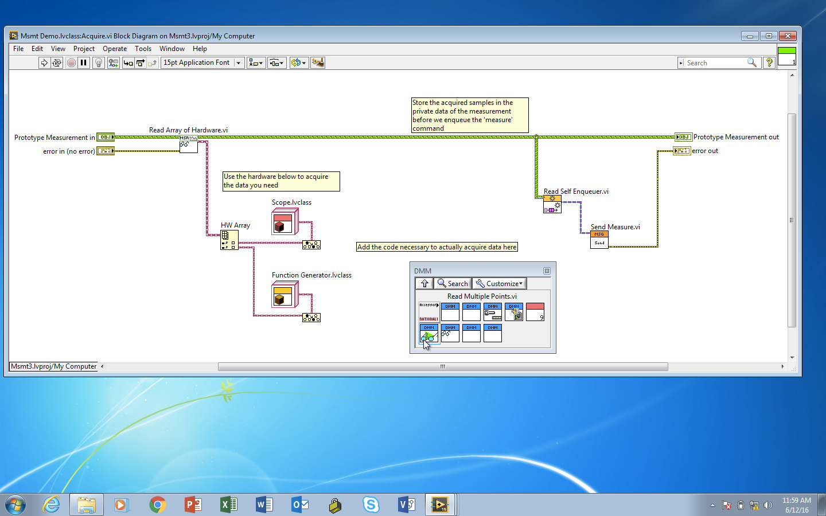

Slide 36
Demonstration
Modify Plugin Code

Slide 37
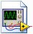
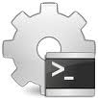
Deploying a Plugin
Startup VI
Application-Specific, Statically Linked Code
Plugin
SubVIs
SubVIs
SubVIs
SubVIs
SubVIs
Static VI Calls
Library A
Library B
LabVIEW
Development Environment
Run-Time Engine
Loaded at run-time
Executable

Slide 38
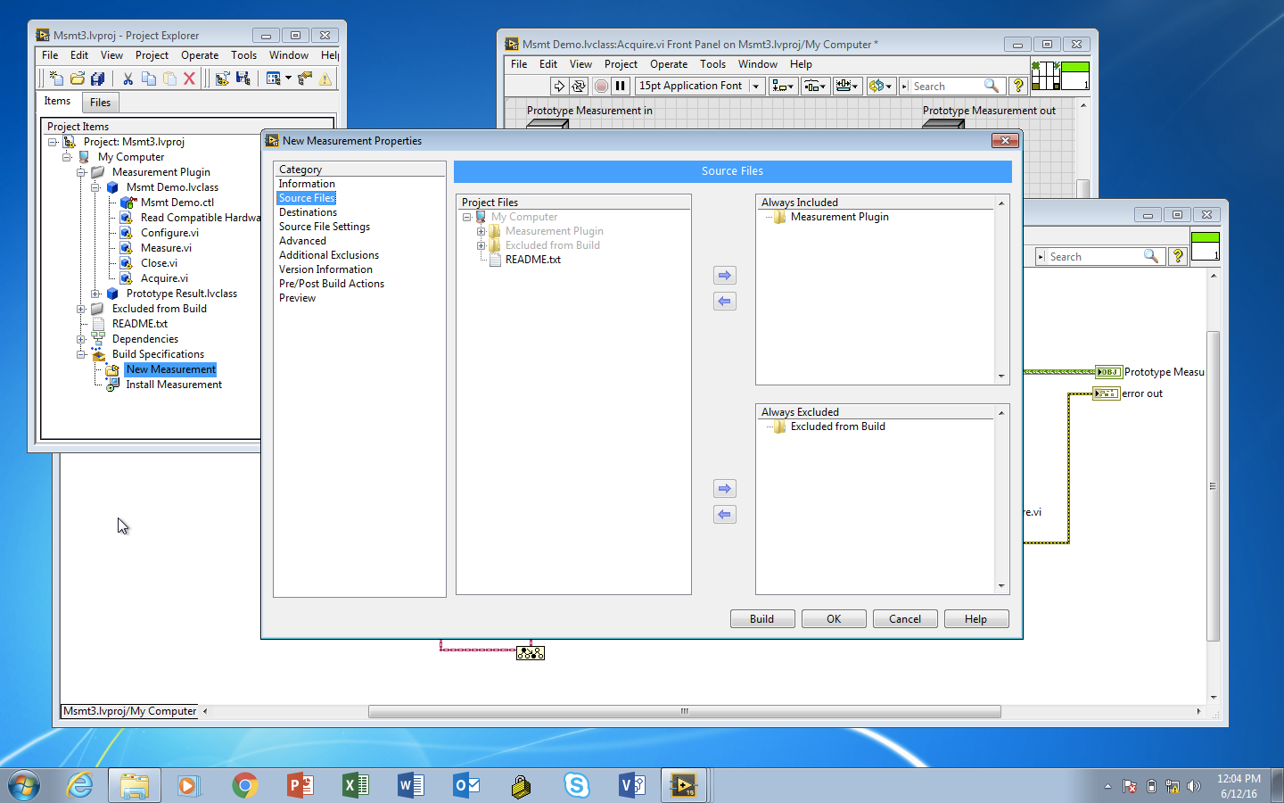

Slide 39
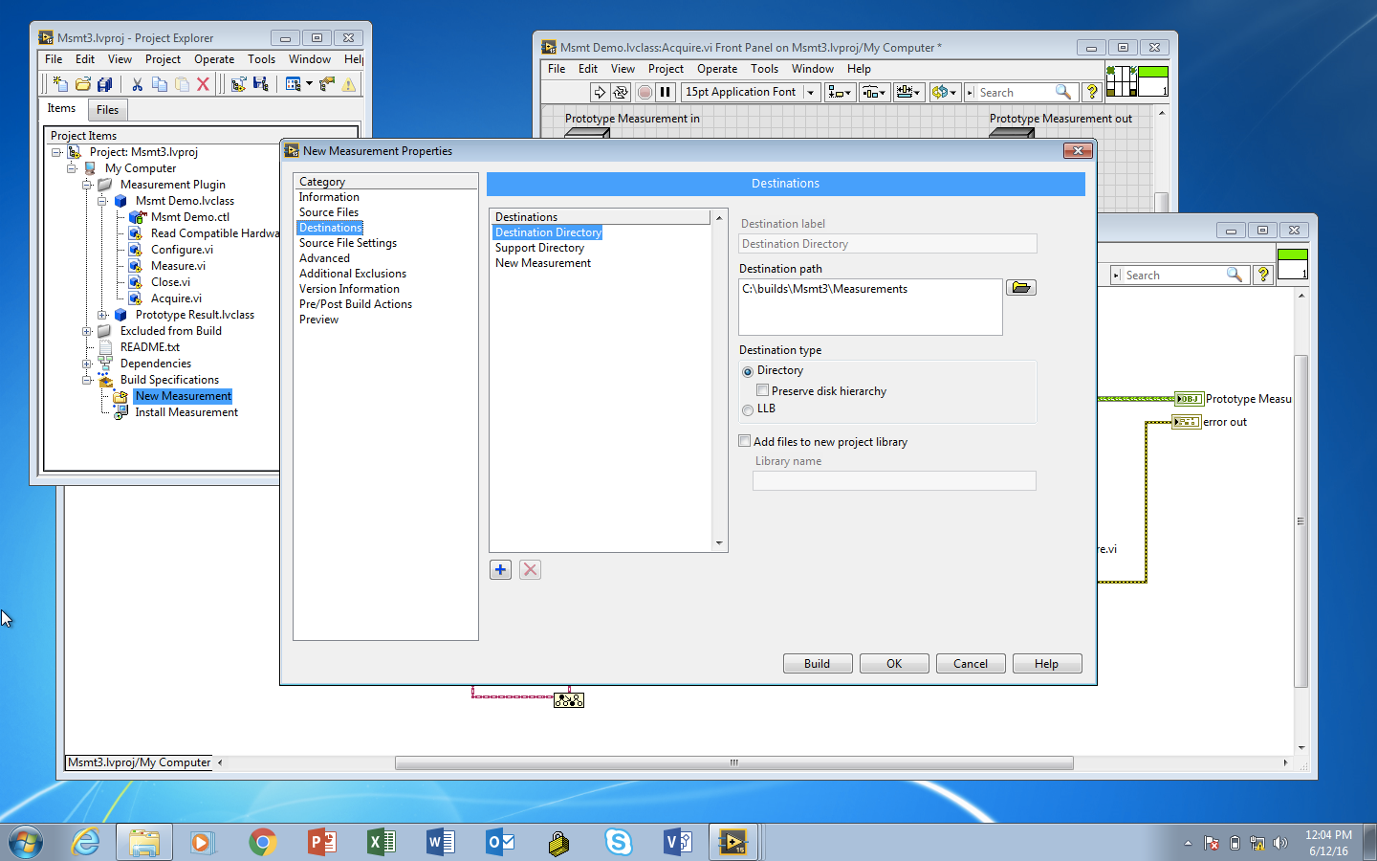

Slide 40


Slide 41


Slide 42
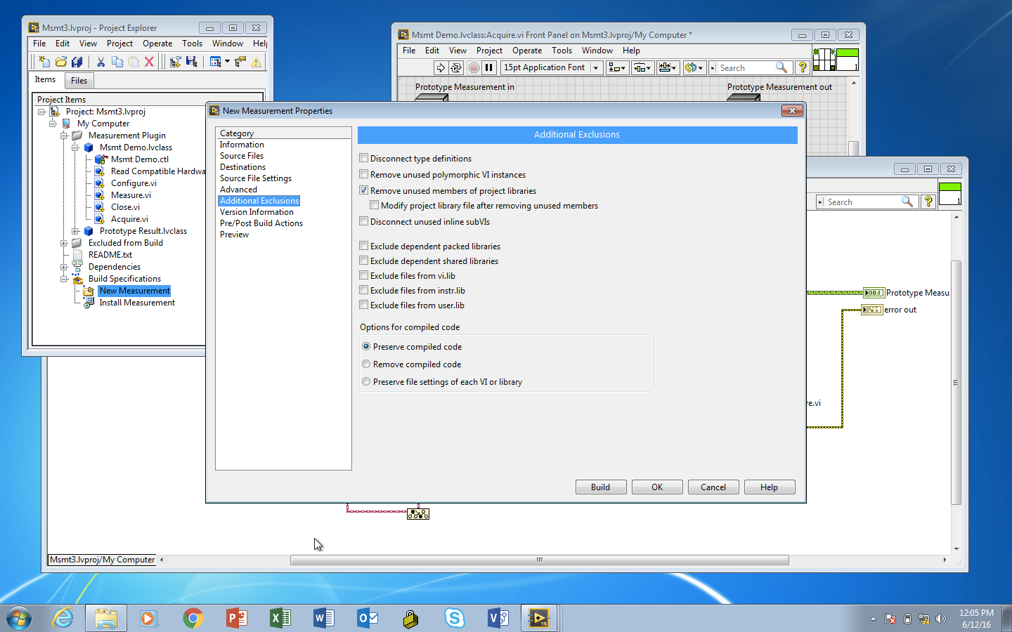

Slide 43
Demonstration
Build and Call Plugin

Slide 44
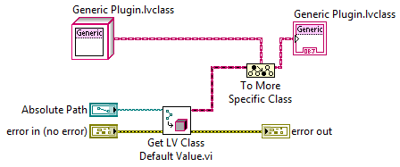


Loading the Plugin Dynamically
A
B
Objects Loaded Into Memory
C
Generic Measurement
← Parent
Location on Disk
Where Measurements are Stored
A
B
C
← Children
Notes:
We will use a factory pattern to load these plugins (quick recap for people who are unfamiliar)

Slide 45
Execution Model

Slide 46
Use Case for the Actor Framework
Queue References
Use the Actor Framework to scale numerous different, but similar consumer loops
Traditional Solution: Dynamically load VI or duplicate code
Notes:
As they scale, there are several challenges with managing communication and avoiding code duplication. We also want to minimize the work required to add new functionality to the system.
These are actors – conceptually, for those of you not familiar with the AF, they are just QMHs.

Slide 47
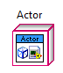
What is an Actor?
₌
An actor is conceptually the same as a queued message handler (QMH) or queued state machine (QSM).

Slide 48
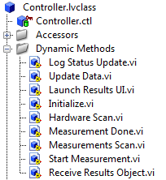
Methods of an Actor are run when a message is received
Log Status Update
Update Data
Launch Results UI
Initialize
Hardware Scan
Measurement Done
₌
Measurement Scan
Start Measurement
Receive Results Object
Methods of an Actor define the messages it can consume

Slide 49
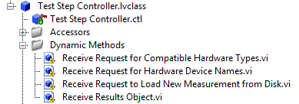
Methods Can be Added or Overriden
Log Status Update
Update Data
Launch Results UI
Initialize
Hardware Scan
Measurement Done
₌
Measurement Scan
Start Measurement
Receive Results Object
Receive Results Object
Overridden
Receive Request for Compatible Hardware Types
Receive Request for Hardware Device Names
Receive Request to Load New Measurement from Disk

Slide 50
A measurement is defined assuming certain classes of devices are available, but without knowing exactly which instrument.
Measurement Class
In this example, this measurement strategy uses a DMM. It assumes an instance of a DMM implements a pre-defined interface, without knowledge of how that interface is implemented
Configure
Acquire
Measure
DMM Class
Configure
Current
Source
Autozero
Read

Slide 51
Other measurements may require different classes of hardware, or perhaps multiple devices (ie: stimulus/response measurements), but we can’t change the connector pane of methods we want to override (like Acquire.vi).
Measurement Class
Configure
Acquire
Measure
?
The objects passed along this wire must all be children of the same parent class

Slide 52
Measurement Class
All measurements use an array of hardware
Configure
Acquire
Measure
But different classes of hardware would definitely not implement the same interface

Slide 53
Measurement Class
Methods can cast hardware objects to specific children at edit-time using the ‘to more specific’ primitive
Configure
Acquire
Measure
DMM
SCOPE
The dark blue wire can be passed into the interfaces for the specific device classes

Slide 54
Test Step
Initialize.vi
Initialize Msg.lvclass
Launch UI.vi
Launch UI Msg.lvclass
User Interface
Launch UI Actor
HW Scan.lvclass
Hardware Scan.vi
Initialize.vi
Msmt Scan.lvclass
Msmt Scan.vi
Disp Msmt.vi
Msmt Selected
Initialize Msg.lvclass
Get HW Info.vi
Matching HW.vi
Request HW Msg.lvclass
Available HW Msg.lvclass
Display Hardware.vi
HW Selected
Validate Selection.vi
Check Validty.vi
Notes:
And finally, this illustrates the behavior of this system.

Slide 55
Test Step
Initialize.vi
Initialize Msg.lvclass
Launch UI.vi
Launch UI Msg.lvclass
User Interface
Launch UI Actor
HW Scan.lvclass
Hardware Scan.vi
Initialize.vi
Msmt Scan.lvclass
Msmt Scan.vi
Disp Msmt.vi
Msmt Selected
Initialize Msg.lvclass
Get HW Info.vi
Matching HW.vi
Request HW Msg.lvclass
Available HW Msg.lvclass
Display Hardware.vi
HW Selected
Validate Selection.vi
Check Validty.vi

Slide 56
HW Selected
Validate Selection.vi
Check Validty.vi
Run Pressed
Send Run Rqst.lvclass
Send Run Request
Start Msmt.vi
Launch Msmt Msg.lvclass
Measurement
Launch Measurement
Checkout HW.vi
Initialize.vi
Config Msmt Msg.lvclass
Configure.vi
Acquire Msg.lvclass
Acquire.vi
Measure Msg.lvclass
Measure.vi
Send Results Msg.lvclass
Receive Results.vi
Close.vi
Stop Msmt Msg.lvclass
Display Results.vi
Display Results Msg.lvclass
Checkin HW.vi

Slide 57
TestStand Integration

Slide 58
Measurement System Class Hierarchy
Only this implementation is different
vi.lib
Actor
User-Developed Code
Controller
User Interface
Measurement
Results
TestStand
API
Test Step Controller
Operator UI
Statically linked
Dynamically Loaded at Run-Time
Plugin
Strain
Resistance
Diode I-V
Frequency Curve
Voltage
Notes:
Lets break this down further. Obviously, everything but vi.lib is user-developed code, but going back to those original goals, we want to minimize the work required to add new functionality. We want to make it possible for someone to add new functionality without being an expert in all the underlying code of this system, or even having to have access to it on their system.

Slide 59
System Description
Blocking
Command
A-Sync
Command
Test Sequence
Controller
Measurement
Result
Result
(unblocks)
TestStand
Measurement Utility
Plugin

Slide 60
HW Selected
Validate Selection.vi
Check Validty.vi
Run Pressed
Send Run Rqst.lvclass
Send Run Request
Start Msmt.vi
Launch Msmt Msg.lvclass
Measurement
Launch Measurement
Checkout HW.vi
Initialize.vi
Config Msmt Msg.lvclass
Configure.vi
Acquire Msg.lvclass
Acquire.vi
Measure Msg.lvclass
Measure.vi
Send Results Msg.lvclass
Receive Results.vi
Close.vi
Stop Msmt Msg.lvclass
Display Results.vi
Display Results Msg.lvclass
Checkin HW.vi

Slide 61
HW Selected
Validate Selection.vi
Check Validty.vi
Run Pressed
Send Run Rqst.lvclass
Send Run Request
Start Msmt.vi
Launch Msmt Msg.lvclass
Measurement
Hardware
Launch Measurement
Checkout HW.vi
Initialize.vi
Config Msmt Msg.lvclass
Configure.vi
Acquire Msg.lvclass
Acquire.vi
Measure Msg.lvclass
Measure.vi
Send Results Msg.lvclass
Receive Results.vi
Close.vi
Stop Msmt Msg.lvclass
Display Results.vi
Display Results Msg.lvclass
Checkin HW.vi
Notes:
Going back to our sequence diagram, I’ve overlaid some additional info to make this clear. When the controller (in the middle) spins up a measurement, it passes several pieces of data to it, including in this case a hardware object. The acquisition method uses that object to acquire.

Slide 62
TestStand
Start Msmt.vi
Launch Msmt Msg.lvclass
Measurement
Hardware
Launch Measurement
Checkout HW.vi
Initialize.vi
Config Msmt Msg.lvclass
Configure.vi
Acquire Msg.lvclass
Acquire.vi
Measure Msg.lvclass
Measure.vi
Send Results Msg.lvclass
Receive Results.vi
Close.vi
Stop Msmt Msg.lvclass
Checkin HW.vi
Notes:
Going back to our sequence diagram, I’ve overlaid some additional info to make this clear. When the controller (in the middle) spins up a measurement, it passes several pieces of data to it, including in this case a hardware object. The acquisition method uses that object to acquire.

Slide 63
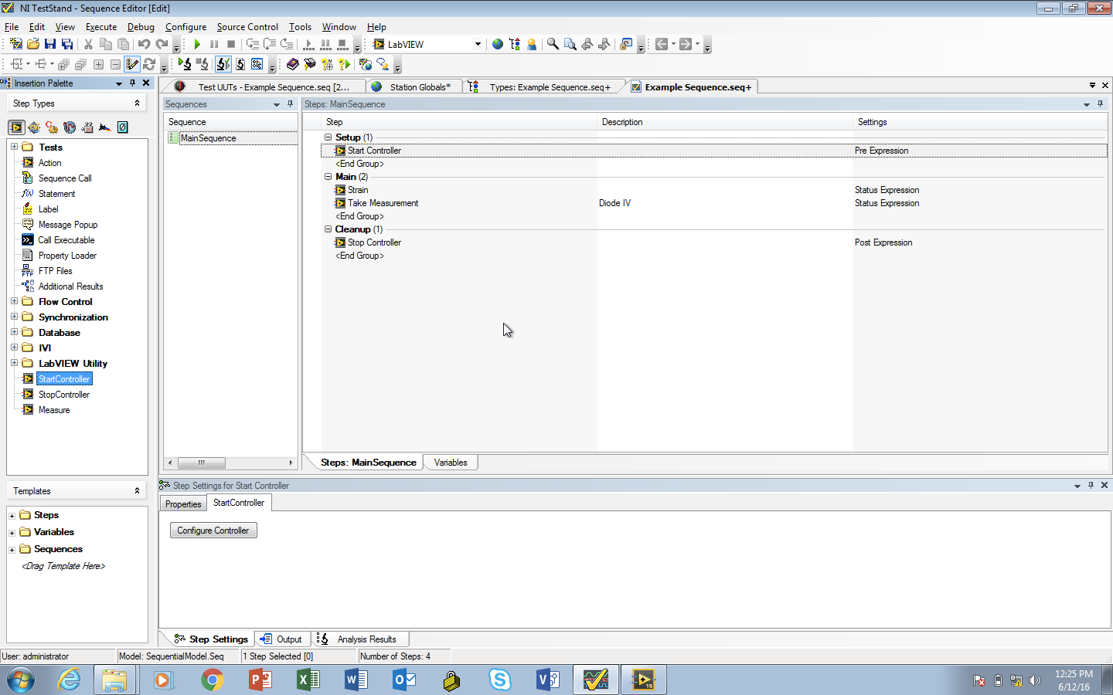

Slide 64
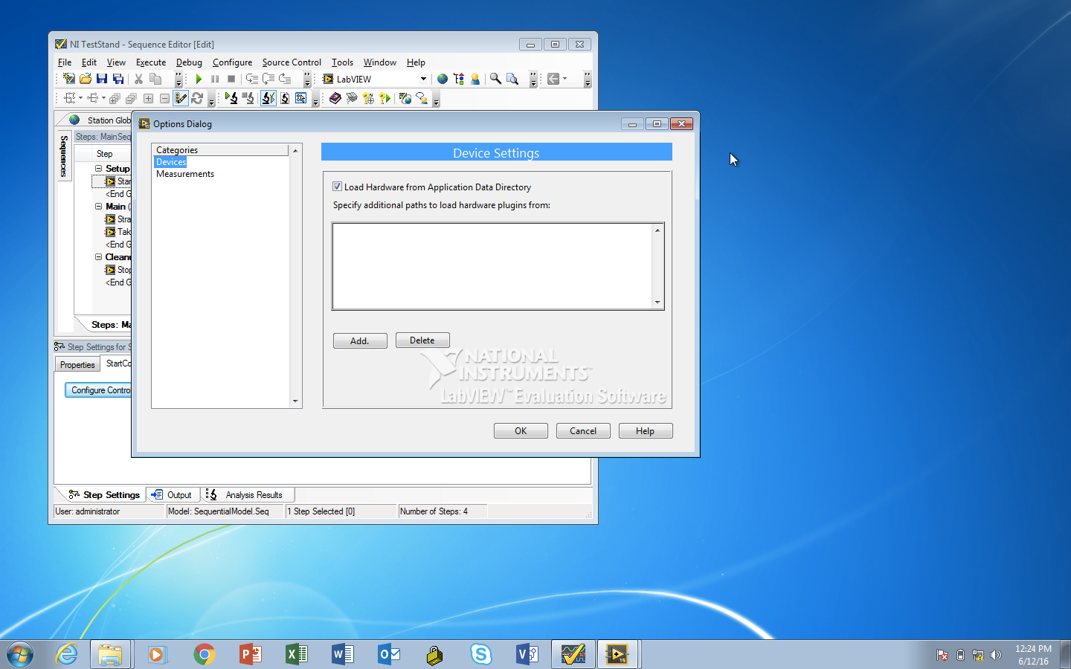

Slide 65
http://bit.ly/lv_oomal
Measurement Utility Reference Example

